Slide 1
The Knowledge Graph Challenge
- Variety of Data
Dr. Ratnesh Sahay
Lead & Associate Director – Clinical Data Science
AstraZeneca, Cambridge, United Kingdom
AI Innovation of Sweden – Invited Talk
Sustainable Knowledge Graphs and AI
Gothenburg, Sweden
25 April 2019
http://www.ratneshsahay.org/

Slide 2


#AboutMe
Present (2018 - Now)
  Lead & Associate Director, Clinical Data Science, AstraZeneca,
  Cambridge, United Kingdom (UK)
Past (1997 - 2018)
  Head of Research Unit – eHealth and Life Sciences, Insight Centre for Data Analytics, NUI Galway, Ireland
  Post Doctoral Research Associate, Digital Enterprise Research Institute (DERI), Galway, Ireland
  PhD & RA at National University of Ireland, Galway, Ireland
  Masters in Computer Science, KTH, Stockholm, Sweden
  Bachelors in IT, University of Southern Queensland, Australia
  Analyst Programmer, Amorphous Health, Malaysia

Slide 3
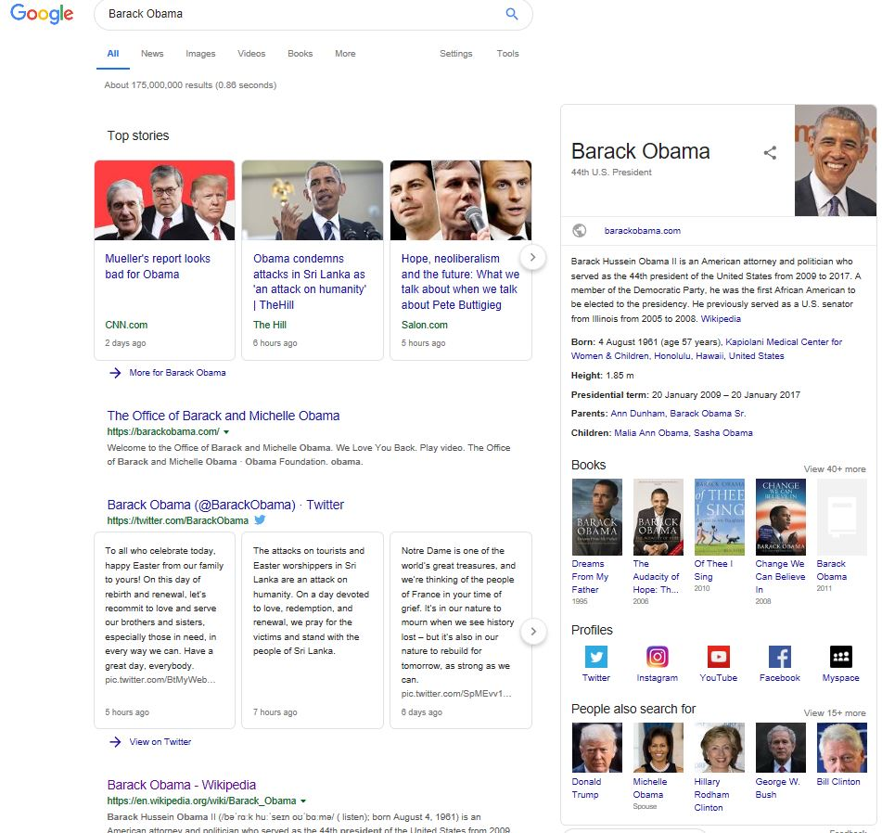
Knowledge Graph (KG) – 2012 & Now
WikiPedia, Wikidata, ..
Yago, KnowledgeVault, WorldNet, GeoNames, ..
Twitter, YouTube, Facebook, ..
Google Search Recommendations

Slide 4
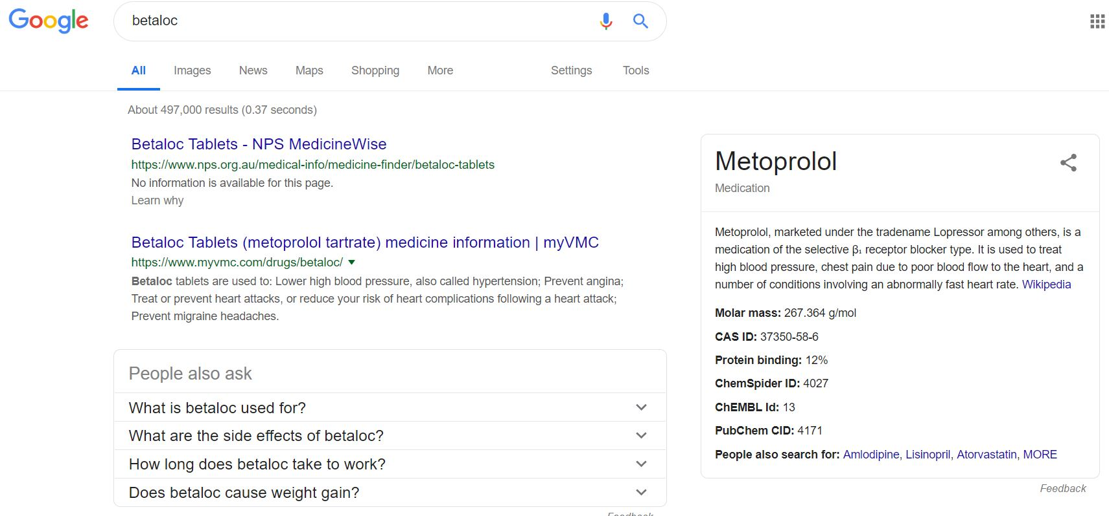

Knowledge Graph (KG) – Pharma Industry
Betaloc
Metoprolol, marketed under the tradename Lopressor among others, is a medication of the selective β₁ receptor blocker type. It is used to treat….(Wikipedia)
Pubmed articles: PMID: 29684876,…
Pubmed number of articles:
2016: 86.945
2017: 65.125
2018: 12.899
Adverse Events: rash, vomit, heart rate, …
Biomarkers: rs1801252, rs1801253,…
Associations: Peyronie’s disease, …
Trade names: Lopressor, …
UBERON_0000948 - Heart + DOID_4 - disease
Granularity of the query: 34%
Drug-Drug interactions: paroxetine, …
Prescriptions: Ischemic heart disease, Cerebrovascular disease, Hypertensive heart disease, Inflammatory heart disease, Rheumatic heart disease
…

Slide 5
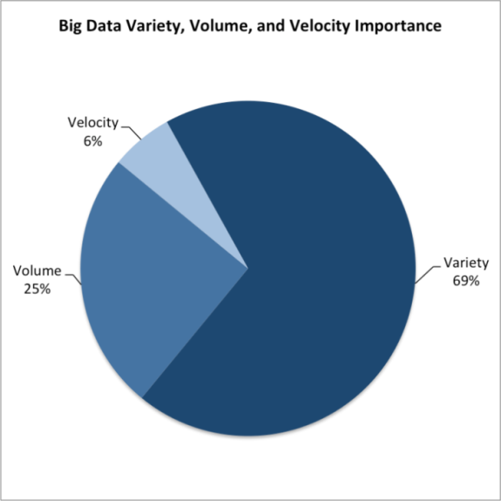
The Challenge – Data Variety
Chart Image source (NewVantage, 2016 ):
https://sloanreview.mit.edu/article/variety-not-volume-is-driving-big-data-initiatives/

Slide 6













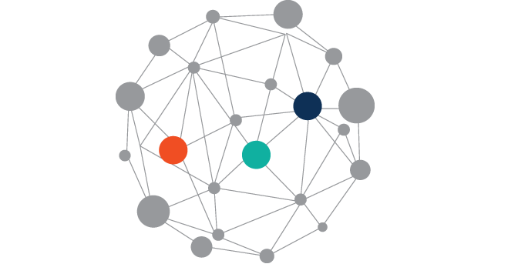

Data Variety - Multiple & Federated Data Sources
Data Conform
Data Context
Data Warehouse
ONE SIZE DOES NOT FIT ALL
Data Curation
Data Mart
Data Wrangling
Data Ingestion
(ETL, etc.)
Data Lake

Slide 7
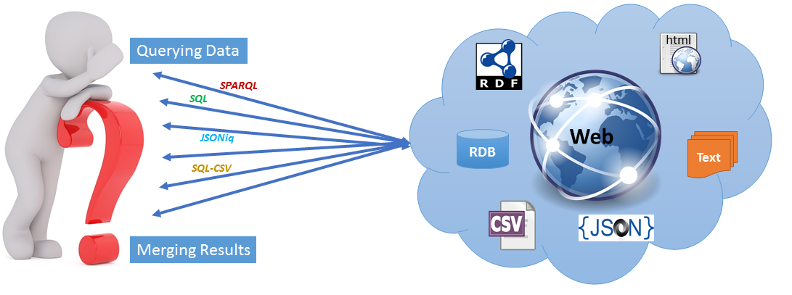
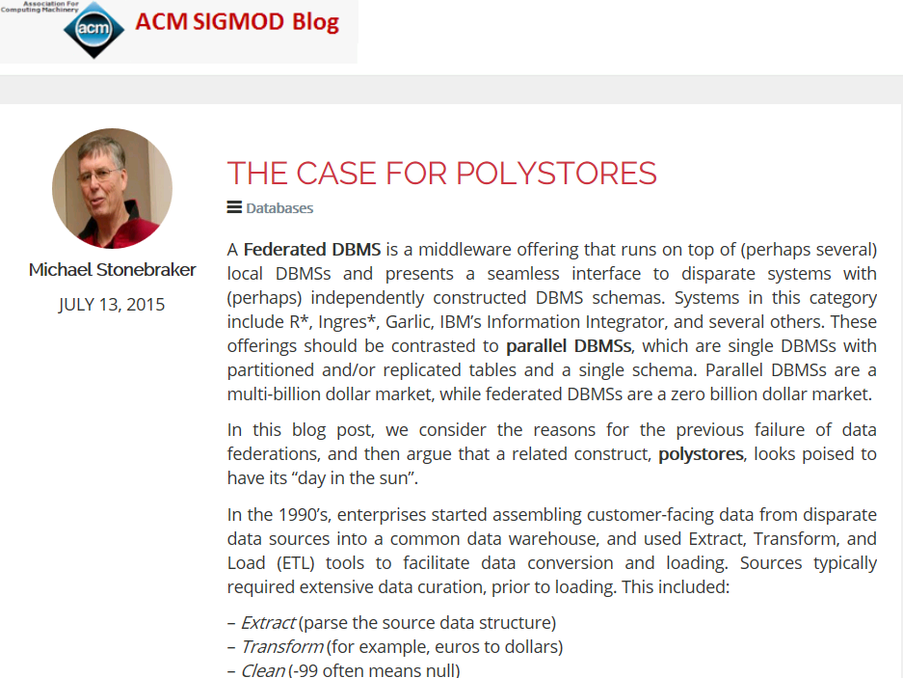
Lesson Learned – Data Warehousing Approach
Huge Data Conversion Cost
Performance Overload
If Data Conversion Involved
  Querying Data Originally Meant for Different Data Model
  Tracking Updates
  Preserving Semantics
The larger debate - Consolidation Vs. Fragmentation

Slide 8
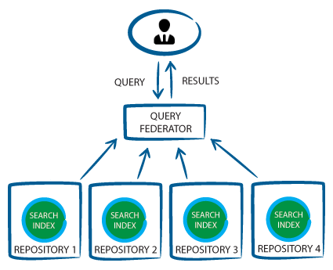
Data Federation – A Long History
Data Federation
  Single data model
  RDB
  SQL
Image Source: Accenture Applied Intelligence
RDB
RDB
RDB
RDB

Slide 9
Data Federation – A Long History
Data Federation
  Single data model
  RDF
  SPARQL

Slide 10

Data Federation – Next Generation
Exploiting Native Data Stores
Multiple Data Models
  RDB, RDF, CSV, JSON etc.
Multiple Query Languages
  SQL, SPARQL, SQL-CSV, Gremlin, Cypher
  JSONiq, NoSQL, etc.
Multiple Locations
Multiple Data Mappings
Multiple Data Access Policies
Multiple Data Access Protocols
  RESTful, etc.
RDB

Slide 11
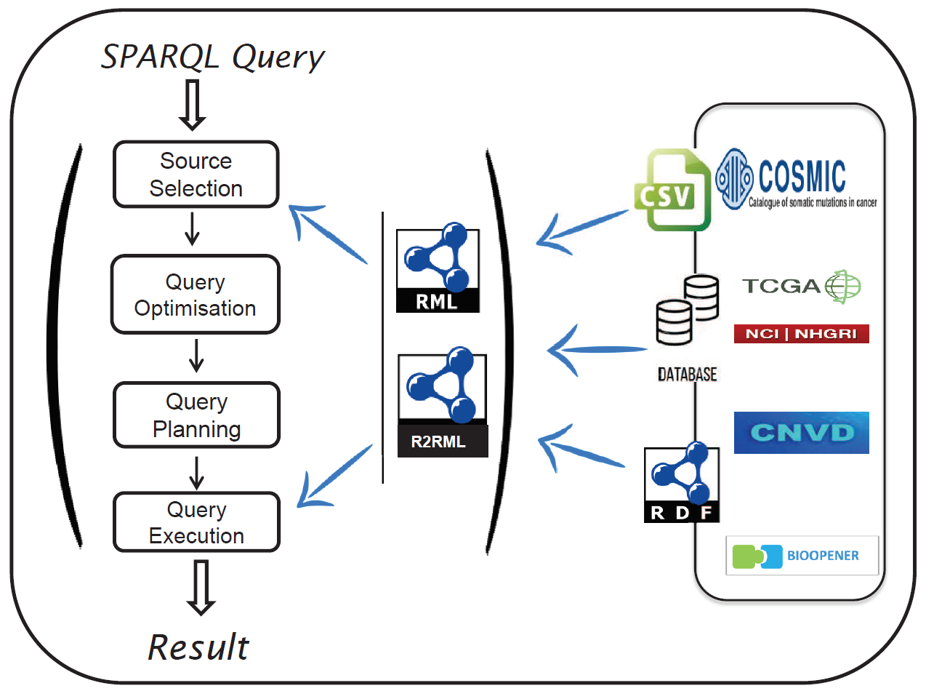
Example PolyStore – Multi-Data Model Querying

Slide 12
Challenges Ahead….
Image Author: Sebastien Dery
Good News (Multi-Data Model Support) - ArangoDB, Azure Cosmos DB, OrientDB, Oracle Database 18c, Virtuoso, etc.
Architectural Design (coming out from the common data warehouse mindset..)
Join Across Multi-Data Models (a topic for future PhD theses !!)
Data Aggregation
Preserving Semantics (we have several years of know-how, e.g., RDB2RDF, D2R, XSPARQL, SQL/SPARQL)

Slide 13
Thank You
Source: https://www.linkedin.com/feed/update/urn:li:activity:6477955590613196800 — LinkedIn post by Scott Taylor

