Slide 1
Semantics in Healthcare and Life Science A personal journey and lessons learned (2005 and continuing)
Dr. Ratnesh Sahay
Lead & Associate Director – Clinical Data Science
AstraZeneca, Cambridge, United Kingdom
AI Innovation of Sweden – Invited Talk
Smart (AI) Healthcare & Life Science
Gothenburg, Sweden
26 April 2019
http://www.ratneshsahay.org/

Slide 2


#AboutMe
Present (2018 - Now)
Lead & Associate Director, Clinical Data Science, AstraZeneca, Cambridge, United Kingdom (UK)
Past (1997 - 2018)
Head of Research Unit – eHealth and Life Sciences, Insight Centre for Analytics, NUI Galway Ireland
Post Doctoral Research Associate, Digital Enterprise Research Institute (DERI), Galway, Ireland
PhD & RA at National University of Ireland, Galway, Ireland
Masters in Computer Science, KTH, Stockholm, Sweden
Bachelors in IT, University of Southern Queensland, Australia
Analyst Programmer, Amorphous Health, Malaysia

Slide 3
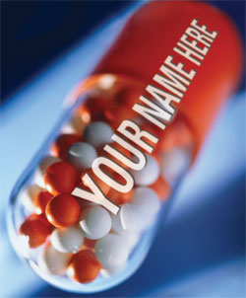
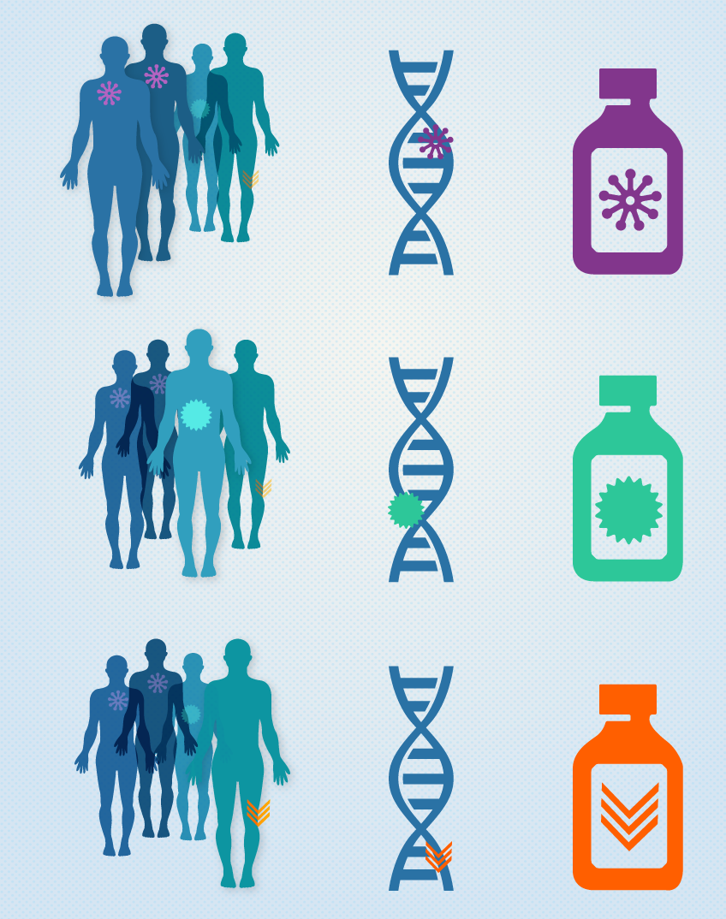
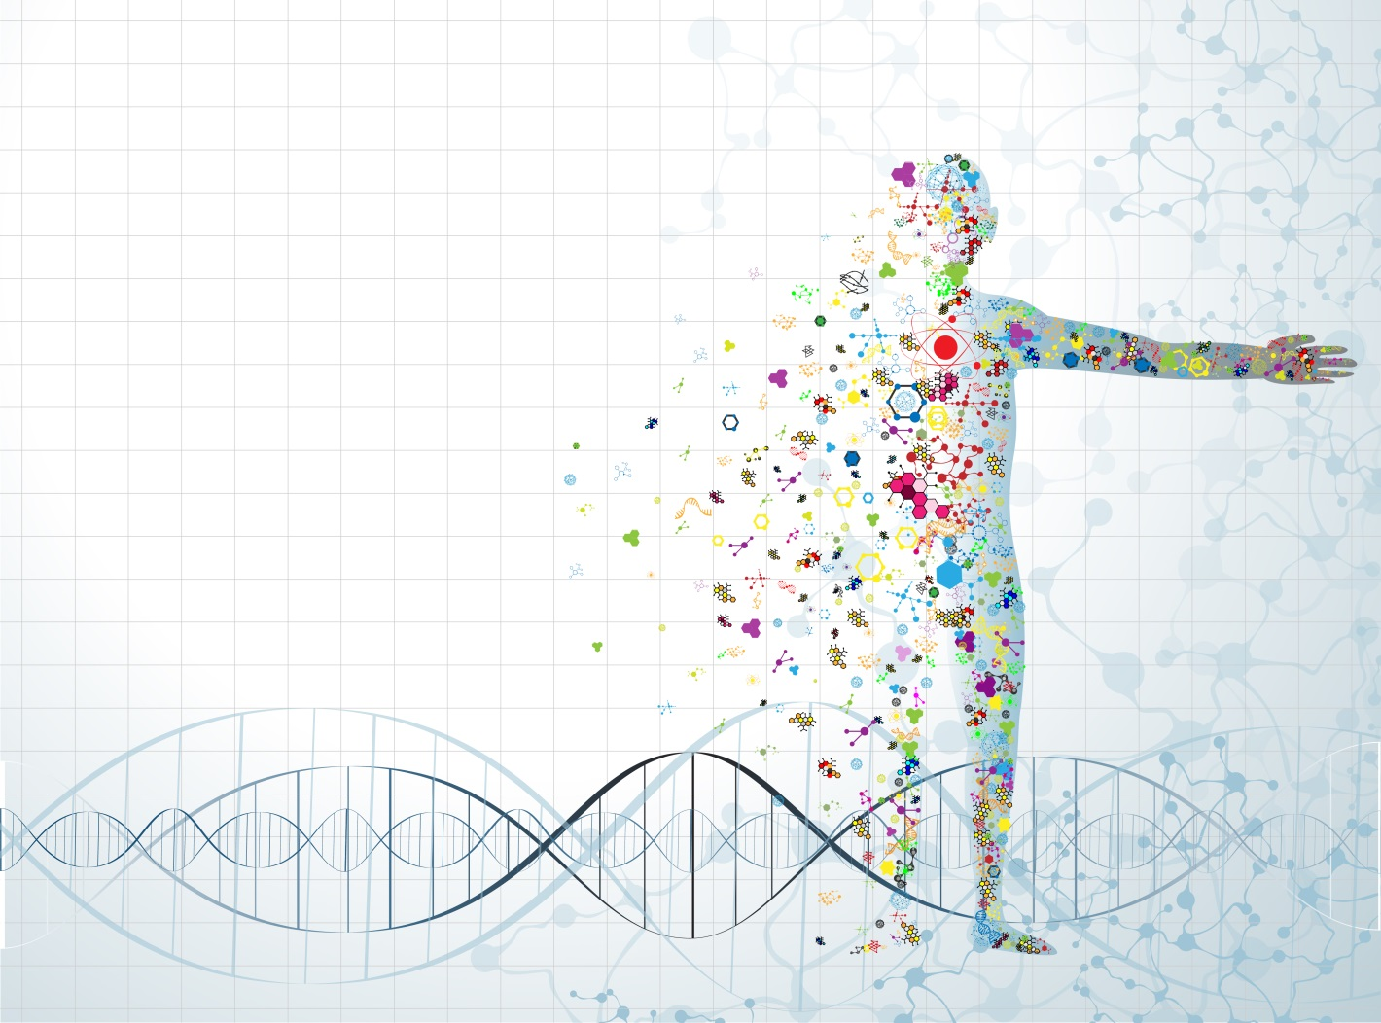
Vision: Patient-Centric Care & Medicine
https://geneticliteracyproject.org/2015/02/03/that-precision-medicine-initiative-a-reality-check/
https://www.cancer.gov/research/areas/treatment/pmi-oncology

Slide 4
Background: Electronic Health Records
1986: IEEE P1157 Medical Data Interchange (MEDIX) committee introduced the concept of a common healthcare data model for Electronic Health Records (EHRs)
1987: HL7 Version 2 (primarily inspired by the MEDIX recommendations)
1995-2005: HL7 Version 3 (no backward compatibility)
Health Level Seven (HL7) V2 is the most widely deployed healthcare standard
2000 onwards: HL7 Integration platforms
End-to-End bidirectional interface development (Mirth, iWay, iNTERFACEWARE)
None provides interoperability between Version 2 and Version 3 applications
Apart from alignment/scalability, there is a problem even for domain experts!
OpenEHR, CEN13606
2004 onwards: Semantic Interoperability for Healthcare
Artemis, RIDE, SemanticHEALTH, SAPHIRE, @neurIST, ACGT, EU-ADR, W3C HCLS, etc.
Plug and Play Electronic Patient Record (PPEPR) started end of 2005
Goal: Alignment Size + Version 2 and Version 3 Interoperability
2012 onwards: HL7 FHIR

Slide 5
Background: AI in Life Sciences
1960: AI in Life Sciences – Dendral Experiments (Stanford University)
first expert system
help organic chemists in identifying unknown organic molecules
1970 - 1980: MYCIN lead by John Patrick McCarthy
identify bacteria causing severe infections
recommend antibiotics, with the dosage adjusted for patient's body weigh
Internist-1, CASNET, SUMEX-AIM
1980 – 2000
Galen, Tambis, Go, Gene, Phenotype, FMA, UMLS

Slide 6


2005 – 2008: Worldwide
Open access information network for secure data exchange on cancer research
Biggest ever support from standard (HL7, ANSI, OASIS, etc.) and industry (IBM, Microsoft, Oracle, etc.)
Core technologies: SOA/Web services, Peer-2-Peer & Grid computing
Continued until 2011

Slide 7







2005-2008 (Me): Plug and Play Electronic Patient Records
EHR
EHR
Laboratory
Emergency
EHR
EHR
Radiology
Oncology

Slide 8

2005 – 2008 (Me): Semantic SOA
Service Registry
Finds
Publish
Web Service
Requestor
Web Service
Provider
Invoke
Service Oriented Architecture

Slide 9

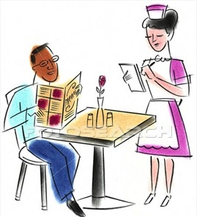



2005- 2008 (Me) :Semantics in Peer2Peer & SOA
Service Definition/
Peer Capability
Service/Peer Registry
Service Choreography &
Orchestration
Service/Peer Discovery

Slide 10
Lesson Learned: Semantics in Peer2Peer & SOA
All the interoperability problems (data, services, processes, peer) cannot be solved in one package
Separate the problems of data interoperability & service/process/peer interoperability
Key blockages:
Search & discovery of resourceful/potential Web services
Search & discovery of resourceful/potential peers
Using ontologies/RDF, like just using XML, does not reduce heterogeneity: it raises heterogeneity problems to a higher level (e.g., ontology matching, ontology alignment, ontology search, etc.)
By 2008, research community shifted/focused primarily to the “data issues”
LD/LOD was emerging !!
BigData was emerging !!

Slide 11
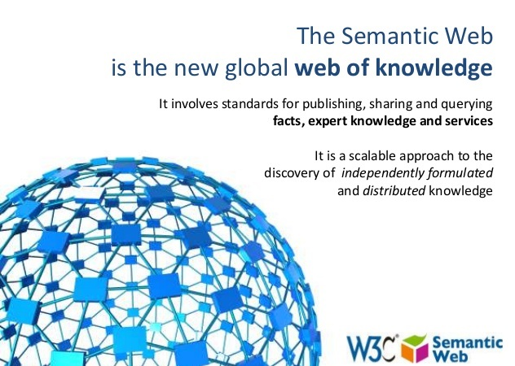

2008 – 2012: Worldwide
http://obamacare-guide.org/
2010: Obamacare
Patient Protection and Affordable Care Act (PPACA)
Expands and improves access to healtcare
2008: W3C Semantic Web Health Care and Life Sciences Interest Group (HCLS IG)
Bio2RDF
Clinical Observation Interoperability

Slide 12
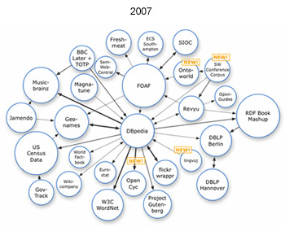
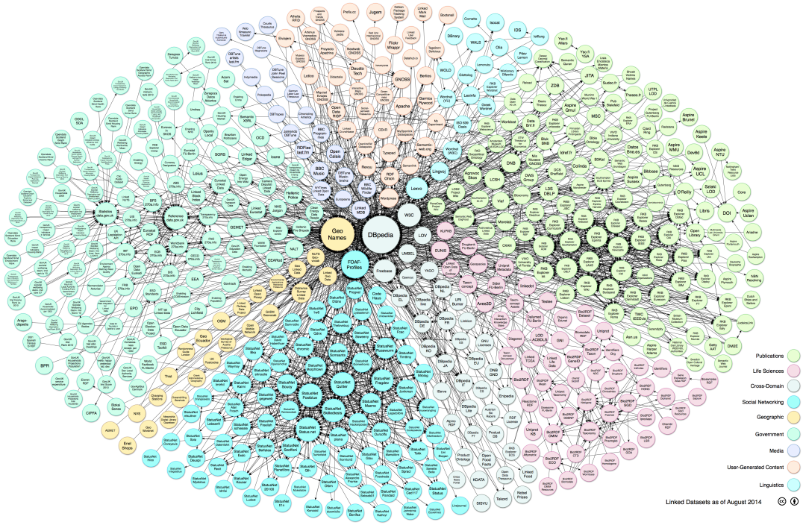
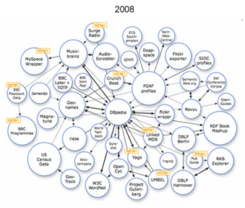
2008 – 2012 (Me): Linked Open Data (LOD)
Domain | Datasets
Media | 22
Geographic | 31
Government | 183
Publications | 96
Cross-domain | 41
Life Sciences | 83 (2014)
Geographic | 21
Social Web | 520
28 Datasets
46 Datasets
2011 – 295 datasets

Slide 13
Lesson Learned: Linked Open Data (LOD)
Delineate/Separate the issues of schema/ontologies (OWL) and data (RDF)
Scalability, Reasoning, Query, Linking, Storage, etc.
Delineate/Separate the scope of Data
Linked Data
Linked Open Data
Open Data
Private Data
Enterprise Data
Tension between Open Data & Data Privacy !!!

Slide 14

2012 – 2018 : Worldwide (Transitioning to GDPR)
https://www.theparliamentmagazine.eu/articles/news/eu-gdpr-comes-force

Slide 15
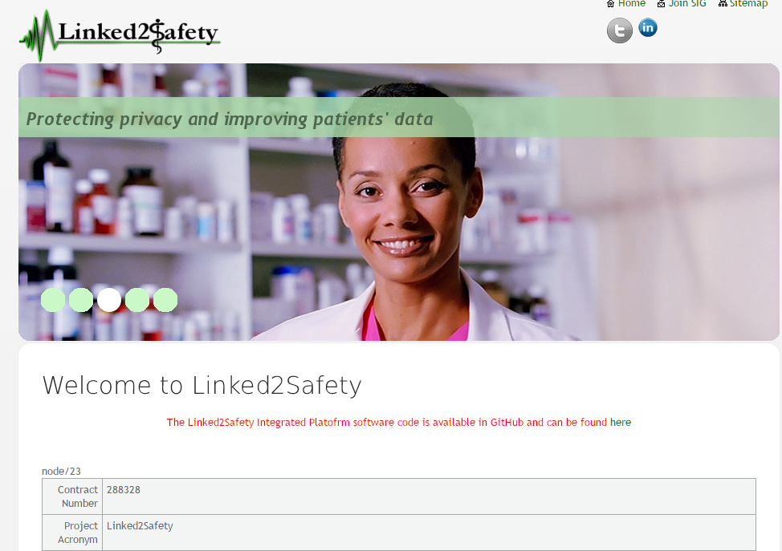



2012-2015 (Me): Privacy & AI Over Patient Data
Linked2safety: Protecting Patient Privacy
Switzerland
Greece
Cyprus

Slide 16
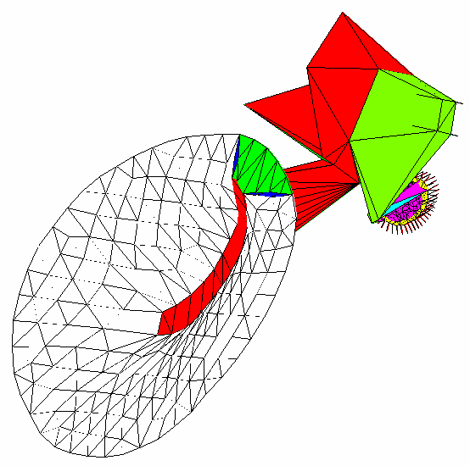
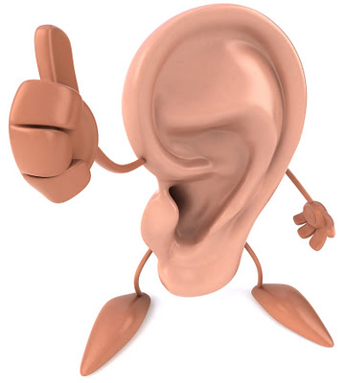
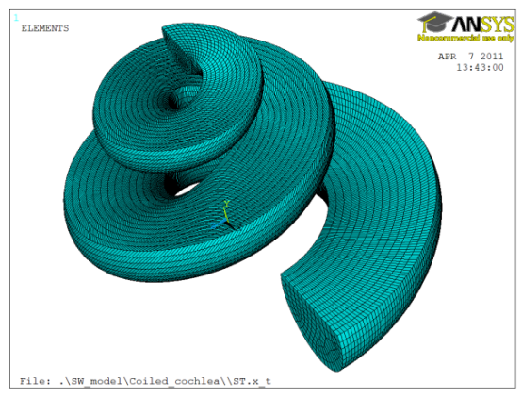
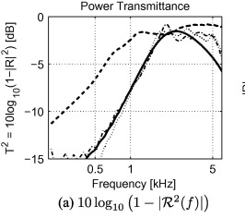


2012-2015 (Me): AI & Bio-simulation for Combating Hearing Impairment
Micromechanics Model
Finite Element Model
Electrical Coupling Model
Fluid Coupling Model

Slide 17
Lesson Learned: Privacy & AI Over Patient Data
Ensuring 100% anonymised/de-identified clinical data (raw or statistical) is a difficult task, especially in rare diseases, thanks to GDPR for the improved clarity
Originally centralised AI algorithms can’t execute over distributed (Web or Open) data
AI algorithms & models (Statistical, Machine Learning, NLP, etc.) need to be adapted/extended for federated + open data infrastructures
Clear boundaries between data interoperability and data analytics

Slide 18

2016 onwards: Worldwide (Cancer Genomics)
Internet of genomics
Federated platform (Genotype - Phenotype)
https://www.ga4gh.org/

Slide 19







2016 onwards (Me): AI + Cancer Genomics Over Linked Data
Gene Symbol
Composite element REF
TCGA_ID
Methylation
ENSEMBL ID
Gene Symbol
GO ID
ENSEMBL ID
Gene Symbol
Reactome ID
GO ID
Gene Symbol
Reactome id
kEGG ID
GENE symbol
Gene Symbol
TCGA_ID
ENSEMBL ID
Beta value
Methylation

Slide 20
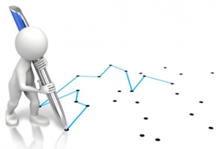
Moving Ahead: Semantics in Healthcare and Life Sciences
In order to connect the dots between AI, Healthcare & Knowledge Graph, we need to answer following:
Is the problem of Search & Discover of datasets/services solved ?
Is the problem of mapping/alignment/linkage of datasets & metadata (schema) is solved ?
How to build usable/adaptable schema & ontologies ?
How FAIR is our data (open or enterprise) ?
Can we apply classical AI algorithms & models over open/distributed/web-based datasets ?
Do we understand the privacy/legal/ethical consequences on HCLS datasets ?
Is this the right time to completely shift focus from data interoperability issues to analytics (AI) ?
What’s a melting point for top-down (ontologies, linked data, etc.) and bottom-up (machine learning) knowledge aggregation ?
In the “one-size-fits-all ” data management solution (data warehouse, data lake, etc.) still relevant in large enterprises ?
http://www.smallregion.com/id/2017/09/23/connecting-dots-connecting-planets/

Slide 21
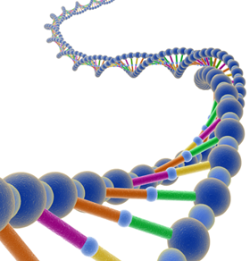
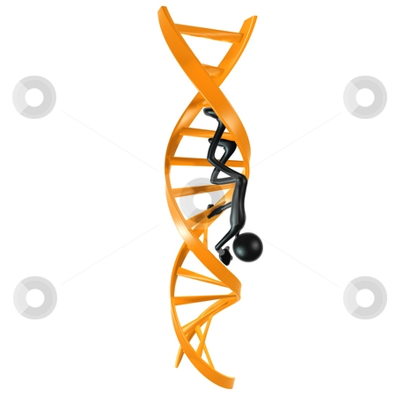
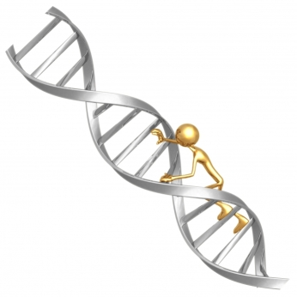

Moving Ahead: Bridging Genotype - Phenotype Traversal
Genotype
Clinical Decision Support
Drug Discovery
Epidemiology
Adverse Event
Phenotype
Public Health
Clinical Trials

Slide 22

Thank You
http://www.ratneshsahay.org

